Slide 1

From Theory to Code: Fixed-Point FIR Filter Design and Output Quality Evaluation
Saikiran Chepa

Slide 2
Contents
1.
Finite Impulse Response (FIR) Filter Design
2.
Floating-Point Representation (Refresher)
3.
Motivation for Fixed Point
4.
Fixed-Point Representation
5.
Float-to-Fixed Conversion
6.
Fixed-Point Arithmetic Examples
7.
Practical Example
8.
Verification
9.
Summary
10.
Hands On

Slide 3

01
PART
Finite Impulse Response (FIR) Filter Design

Slide 4
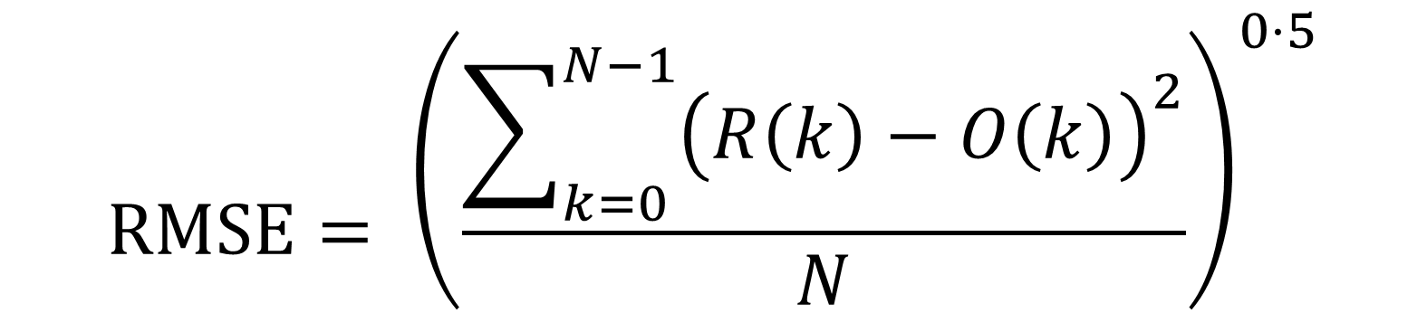
$$RMSE= {\left(\frac{\sum_{k=0}^{N−1}{{\left(R\left(k\right)−O\left(k\right)\right)}^{2}}}{N}\right)}^{0⋅5}$$

Slide 5



Linear-phase design (symmetrical coefficients)
Always stable (no feedback terms)
Output depends only on current and past inputs
01.

Slide 6
x[n] = A₁*Sin(w₁*n) + A₂*Sin(w₂*n) y[n] = A₁*|H(e^{jw1})|*Sin(w₁*n – w₁*n0) + A₂ *|H(e^{jw2})|* Sin(w₂*n-w₂*n0) y[n] = A₃*Sin(w₁*(n – n0)) + A₄*Sin(w₂*(n-n0))

Slide 7
General Equation: $y\left(n\right)=\sum_{k=0}^{M−1}{h\left(k\right)}⋅x\left(n−k\right)$
01
02
ℎ 𝑘 = filter coefficients
𝑥 𝑛 = input signal
03
04
𝑦 𝑛 = output signal
M = number of taps

Slide 8

How to do Convolution??
Direct Convolution
Multiply- accumulate (MAC) for each output sample ComplexityO(N·M) (N = input length, M = filter length) Simple but expensive for large filters
Overlap-Add (OLA)
Input split into blocks Each block convolved using FFT Results added with overlap Efficient for long filters
Overlap-Save (OLS)
Input divided into overlapping blocks FFT- based convolution, discarding invalid samples Memory- efficient alternative to OLA

Slide 9
Filter Coefficients
1 | 2 | 3 | 4
1 | 2
1 | 2
Frame 1
1 | 2 | 3 | 4
Frame 2
5 | 6 | 7 | 8
Delay Line
0 | 0 | 0 | 0 | 0
Output
1 | 4 | 7 | 10 | 13 | 16 | 19 | 22 | 16

Slide 10
Filter Coefficients
1 | 2 | 3 | 4
1 | 2
1 | 2
Frame 1
1 | 2 | 3 | 4
Frame 2
5 | 6 | 7 | 8
Delay Line
0 | 1 | 2 | 3 | 4
2 | 1
Y[0] = 1*1 + 2*0 = 1
Output
1 | 4 | 7 | 10 | 13 | 16 | 19 | 22 | 16

Slide 11
Filter Coefficients
1 | 2 | 3 | 4
1 | 2
1 | 2
Frame 1
1 | 2 | 3 | 4
Frame 2
5 | 6 | 7 | 8
Delay Line
0 | 1 | 2 | 3 | 4
2 | 1
Y[1] = 1*2 + 2*1 = 4
Output
1 | 4 | 7 | 10 | 13 | 16 | 19 | 22 | 16

Slide 12
Filter Coefficients
1 | 2 | 3 | 4
1 | 2
1 | 2
Frame 1
1 | 2 | 3 | 4
Frame 2
5 | 6 | 7 | 8
Delay Line
0 | 1 | 2 | 3 | 4
2 | 1
Y[2] = 1*3 + 2*2 = 7
Output
1 | 4 | 7 | 10 | 13 | 16 | 19 | 22 | 16

Slide 13
Filter Coefficients
1 | 2 | 3 | 4
1 | 2
1 | 2
Frame 1
1 | 2 | 3 | 4
Frame 2
5 | 6 | 7 | 8
Delay Line
0 | 1 | 2 | 3 | 4
2 | 1
Y[3] = 1*4 + 2*3 = 10
Output
1 | 4 | 7 | 10 | 13 | 16 | 19 | 22 | 16

Slide 14
Filter Coefficients
1 | 2 | 3 | 4
1 | 2
1 | 2
Frame 1
1 | 2 | 3 | 4
Frame 2
5 | 6 | 7 | 8
Delay Line
0 | 1 | 2 | 3 | 4
Output
1 | 4 | 7 | 10 | 13 | 16 | 19 | 22 | 16

Slide 15
Filter Coefficients
1 | 2 | 3 | 4
1 | 2
1 | 2
Frame 1
1 | 2 | 3 | 4
Frame 2
5 | 6 | 7 | 8
Delay Line
4 | 1 | 2 | 3 | 4
Output
1 | 4 | 7 | 10 | 13 | 16 | 19 | 22 | 16

Slide 16
Filter Coefficients
1 | 2 | 3 | 4
1 | 2
1 | 2
Frame 1
1 | 2 | 3 | 4
Frame 2
5 | 6 | 7 | 8
Delay Line
4 | 5 | 6 | 7 | 8
Output
1 | 4 | 7 | 10 | 13 | 16 | 19 | 22 | 16

Slide 17
Filter Coefficients
1 | 2 | 3 | 4
1 | 2
1 | 2
Frame 1
1 | 2 | 3 | 4
Frame 2
5 | 6 | 7 | 8
Delay Line
4 | 5 | 6 | 7 | 8
2 | 1
Y[4] = 1*5 + 2*4 = 13
Output
1 | 4 | 7 | 10 | 13 | 16 | 19 | 22 | 16

Slide 18
Filter Coefficients
1 | 2 | 3 | 4
1 | 2
1 | 2
Frame 1
1 | 2 | 3 | 4
Frame 2
5 | 6 | 7 | 8
Delay Line
4 | 5 | 6 | 7 | 8
2 | 1
Y[5] = 1*6 + 2*5 = 16
Output
1 | 4 | 7 | 10 | 13 | 16 | 19 | 22 | 16

Slide 19
Filter Coefficients
1 | 2 | 3 | 4
1 | 2
1 | 2
Frame 1
1 | 2 | 3 | 4
Frame 2
5 | 6 | 7 | 8
Delay Line
4 | 5 | 6 | 7 | 8
2 | 1
Y[6] = 1*7 + 2*6 = 19
Output
1 | 4 | 7 | 10 | 13 | 16 | 19 | 22 | 16

Slide 20
Filter Coefficients
1 | 2 | 3 | 4
1 | 2
1 | 2
Frame 1
1 | 2 | 3 | 4
Frame 2
5 | 6 | 7 | 8
Delay Line
4 | 5 | 6 | 7 | 8
2 | 1
Y[7] = 1*8 + 2*7 = 22
Output
1 | 4 | 7 | 10 | 13 | 16 | 19 | 22 | 16

Slide 21
Filter Coefficients
1 | 2 | 3 | 4
1 | 2
1 | 2
Frame 1
1 | 2 | 3 | 4
Frame 2
5 | 6 | 7 | 8
Delay Line
4 | 5 | 6 | 7 | 8
Output
1 | 4 | 7 | 10 | 13 | 16 | 19 | 22 | 16

Slide 22
Filter Coefficients
1 | 2 | 3 | 4
1 | 2
1 | 2
Frame 1
1 | 2 | 3 | 4
Frame 2
5 | 6 | 7 | 8
Delay Line
8 | 5 | 6 | 7 | 8
Output
1 | 4 | 7 | 10 | 13 | 16 | 19 | 22 | 16

Slide 23
Filter Coefficients
1 | 2 | 3 | 4
1 | 2
1 | 2
Frame 1
1 | 2 | 3 | 4
Frame 2
5 | 6 | 7 | 8
Delay Line
8 | 0 | 0 | 0 | 0
Output
1 | 4 | 7 | 10 | 13 | 16 | 19 | 22 | 16

Slide 24
Filter Coefficients
1 | 2 | 3 | 4
1 | 2
1 | 2
Frame 1
1 | 2 | 3 | 4
Frame 2
5 | 6 | 7 | 8
Delay Line
8 | 0 | 0 | 0 | 0
2 | 1
Y[8] = 1*0 + 2*8 = 16
Output
1 | 4 | 7 | 10 | 13 | 16 | 19 | 22 | 16

Slide 25
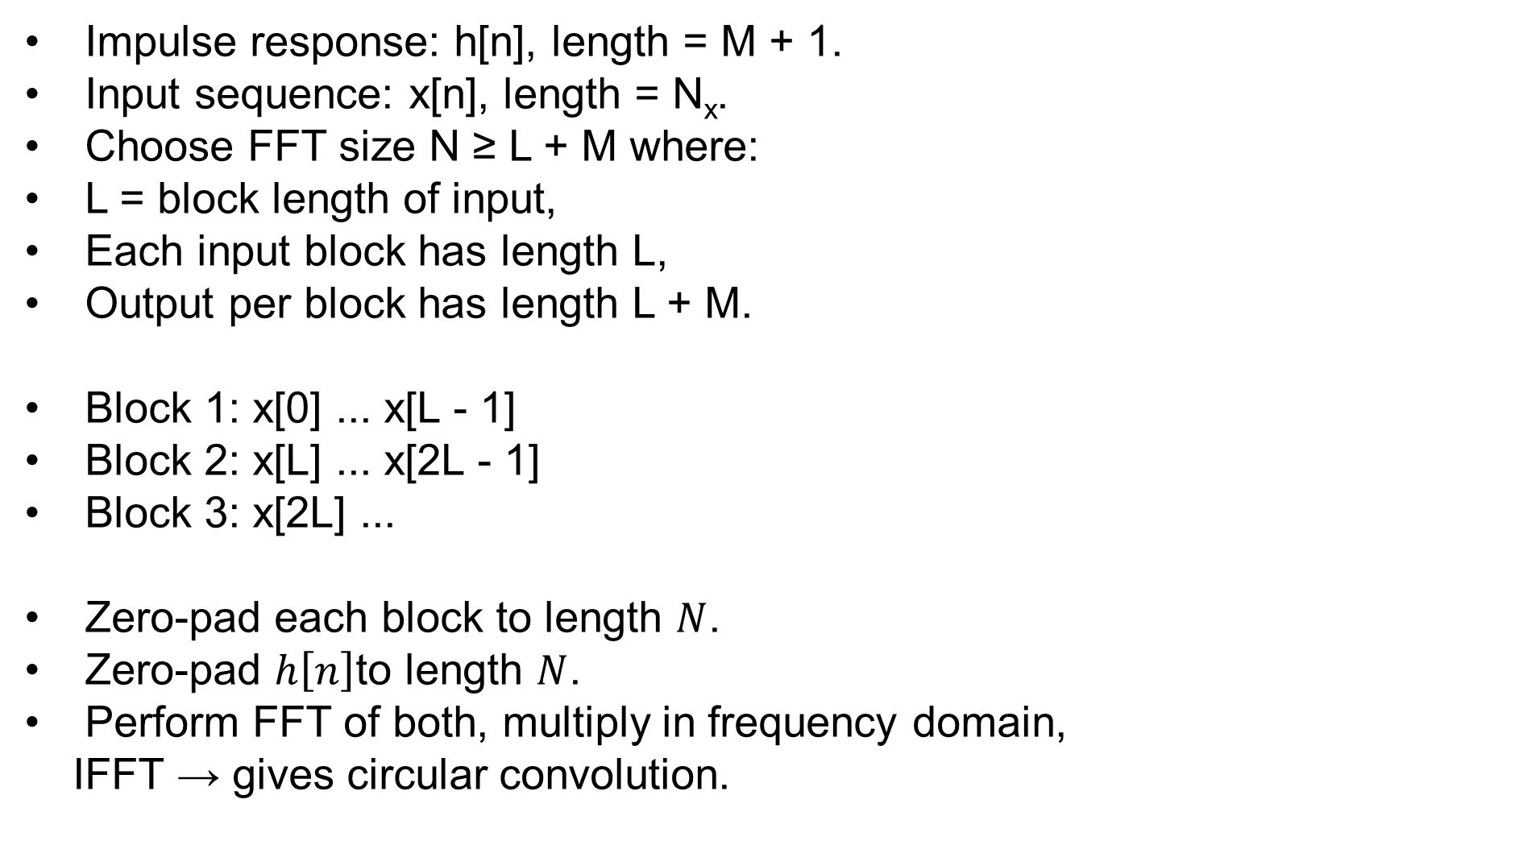
Overlap and Add Method
Impulse response: h[n], length = M + 1.
Input sequence: x[n], length = N_{x}.
Choose FFT size N ≥ L + M where:
L = block length of input,
Each input block has length L,
Output per block has length L + M.
Block 1: x[0] ... x[L - 1]
Block 2: x[L] ... x[2L - 1]
Block 3: x[2L] ...
Zero-pad each block to length $N$.
Zero-pad $h\left[n\right]$to length $N$.
Perform FFT of both, multiply in frequency domain,
IFFT → gives circular convolution.

Slide 26
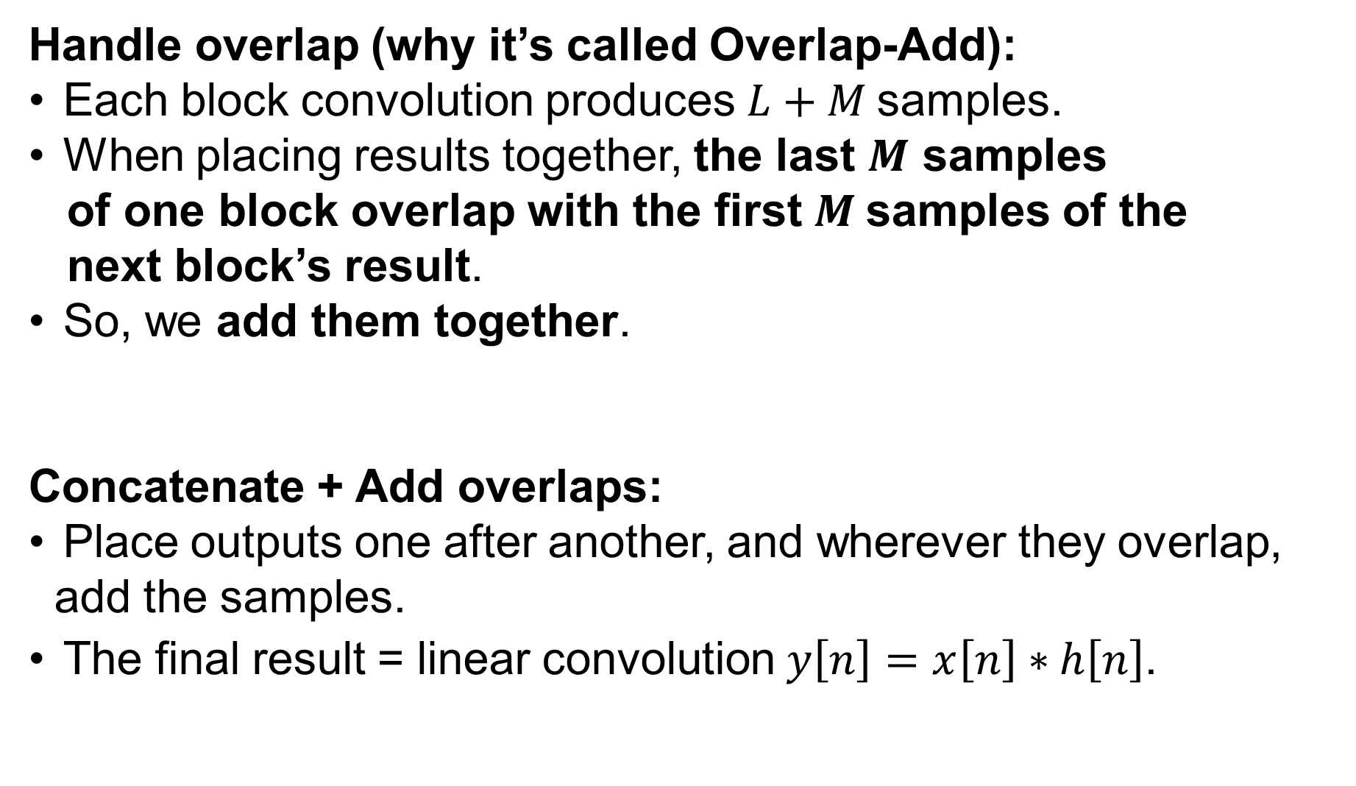
Handle overlap (why it’s called Overlap-Add):
Each block convolution produces $L+M$samples.
When placing results together, the last $M$ samples
of one block overlap with the first $M$samples of the
next block’s result.
So, we add them together.
Concatenate + Add overlaps:
Place outputs one after another, and wherever they overlap,
add the samples.
The final result = linear convolution $y\left[n\right]=x\left[n\right]∗h\left[n\right]$.

Slide 27
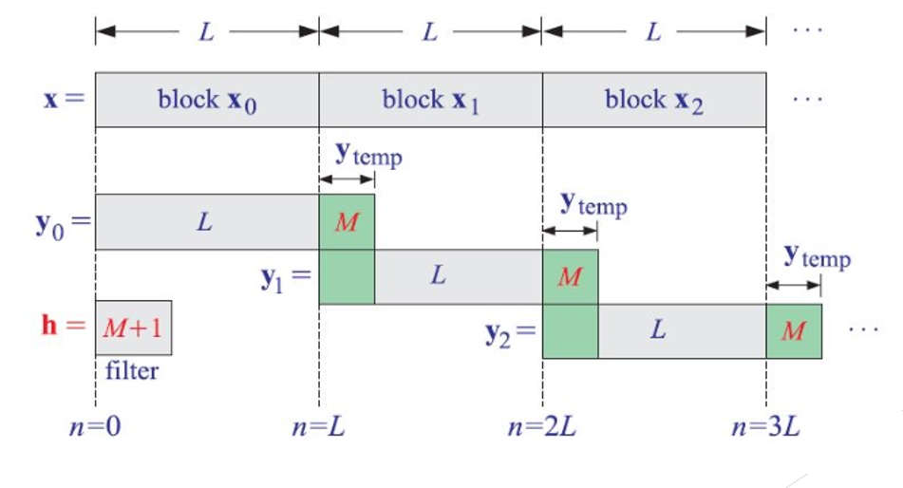

Slide 28
Circular Convolution
Y[n] = $\sum_{m=0}^{N−1}{x}\left(m\right)⋅h\left(\left(n−m\right)\operatorname{mod}{N}\right)$ n=0,1,…,(N-1)
Key Points:
Signals are assumed periodic with period N.
Output length is always N.
Extra terms wrap around and add at the beginning of the output.

Slide 29
Input block: x = [1,2,3,4] , length N = 4.
Filter: h = [1,1,1] , length M = 3
y_{linear}​ = [1,3,6,9,7,4]
Y[0] = x[0]*h[(0-0) mod N] + x[1]*h[[(0-1) mod N]+ x[2]*h[(0-2) mod N] + x[3]*h[[(0-3) mod N]
= 1*1+2*0+3*1+4*1 = 8
Y[1] = x[0]*h[(1-0) mod N] + x[1]*h[[(1-1) mod N]+ x[2]*h[(1-2) mod N] + x[3]*h[[(1-3) mod N]
= 1*1+2*1+3*0+4*1 = 7
Y[2] = x[0]*h[(2-0) mod N] + x[1]*h[[(2-1) mod N]+ x[2]*h[(2-2) mod N] + x[3]*h[[(2-3) mod N]
= 1*1+2*1+3*1+4*0 = 6
Y[3] = x[0]*h[(3-0) mod N] + x[1]*h[[(3-1) mod N]+ x[2]*h[(3-2) mod N] + x[3]*h[[(3-3) mod N]
= 1*0+2*1+3*1+4*1 = 9

Slide 30
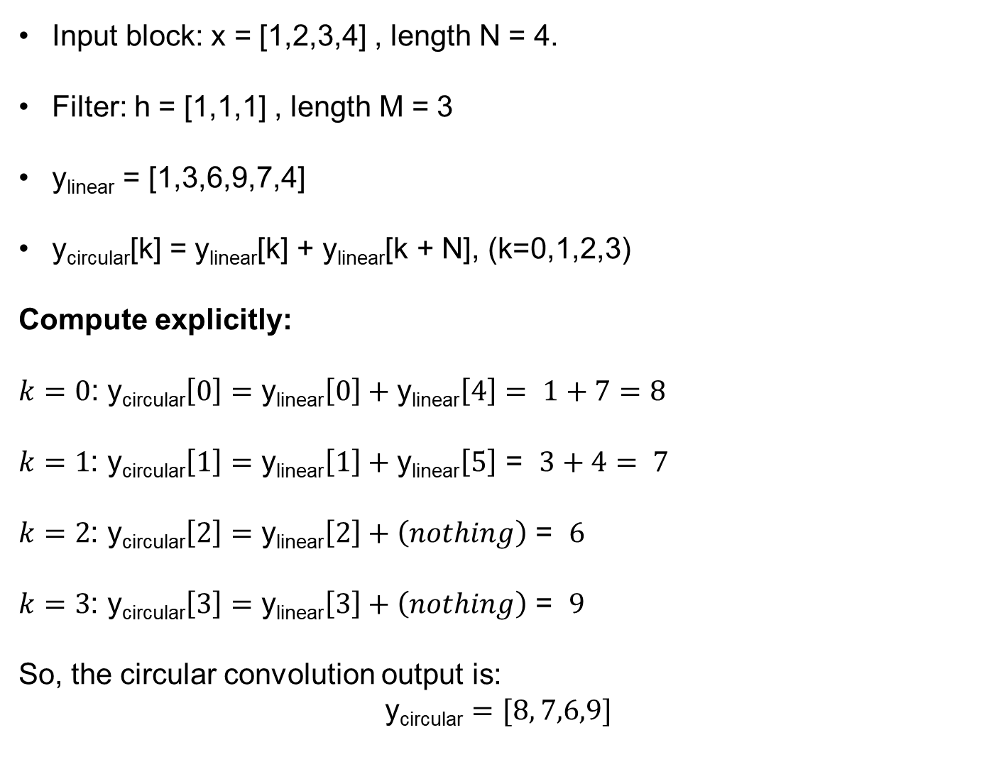
Input block: x = [1,2,3,4] , length N = 4.
Filter: h = [1,1,1] , length M = 3
y_{linear}​ = [1,3,6,9,7,4]
y_{circular}​[k] = y_{linear}​[k] + y_{linear}​[k + N], (k=0,1,2,3)
Compute explicitly:
$k=0$: y_{circular}​$\left[0\right]=\text{y}\text{linear}\left[0\right]+\text{y}\text{linear}\left[4\right]=$ $1+7=8$
$k=1$: y_{circular}​$\left[1\right]=\text{y}\text{linear}\left[1\right]+\text{y}\text{linear}\left[5\right]$ = $3+4= 7$
$k=2$: y_{circular}​$\left[2\right]=\text{y}\text{linear}\left[2\right]+\left(nothing\right)$ = $6$
$k=3$: y_{circular}​$\left[3\right]=\text{y}\text{linear}\left[3\right]+\left(nothing\right)$ = $9$
So, the circular convolution output is:
$$\text{y}\text{circular}=[8, 7,6,9]$$

Slide 31
Overlap and Save Method
Let input sequence = x[n], n = 0,1,…,Nx−1
Filter impulse response = h[n], length M+1
Choose FFT size N such that N ≥ (M+1)
Each processed block will output N−M
Segment 1: x[0] ... x[N-1]
Segment 2: x[N-M] ... x[2N-M-1]
Segment 3: x[2N-2(M)] ...

Slide 32
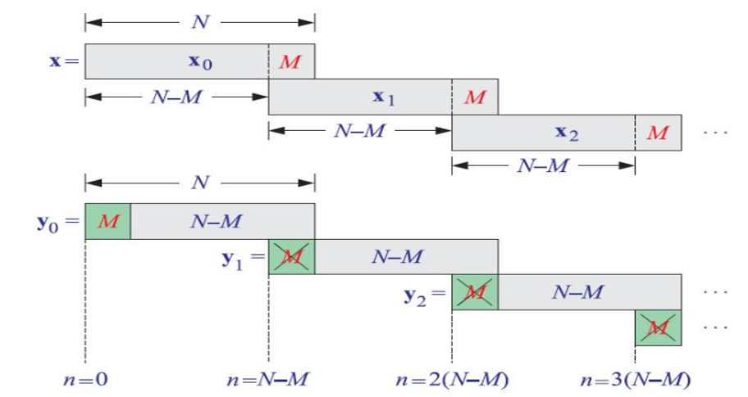

Slide 33
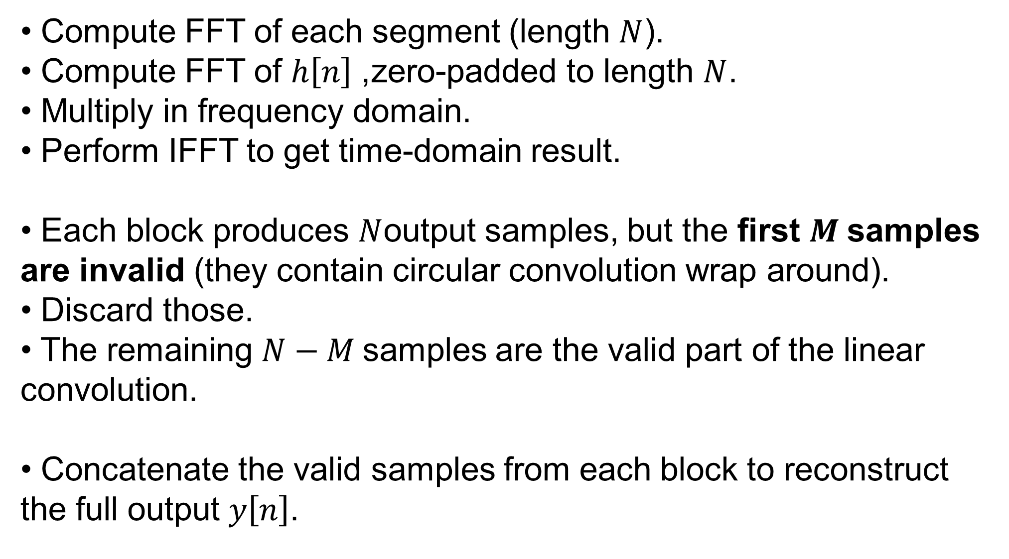
Compute FFT of each segment (length $N$).
Compute FFT of $h\left[n\right]$, zero-padded to length $N$.
Multiply in frequency domain.
Perform IFFT to get time-domain result.
Each block produces $N$output samples, but the first $M$samples are invalid (they contain circular convolution wrap around).
Discard those.
The remaining $N−M$samples are the valid part of the linear convolution.
Concatenate the valid samples from each block to reconstruct the full output $y\left[n\right]$.

Slide 34
02
PART
Floating-Point Representation (Refresher)

Slide 35
IEEE 754 format (32-bit float)
01
Sign bit (1)
04
Advantages wide dynamic range, easy for algorithm development
02
Exponent (8)
05
Limitation not always efficient for embedded
03
Mantissa (23)

Slide 36
03
PART
Motivation for Fixed Point

Slide 37
Why fixed-point?
Lower power, smaller memory footprint
Faster execution on embedded DSP/MCU
Hardware limitations (many DSPs lack floating- point units)
Typical applicationsSpeech/audio codecs, filters

Slide 38
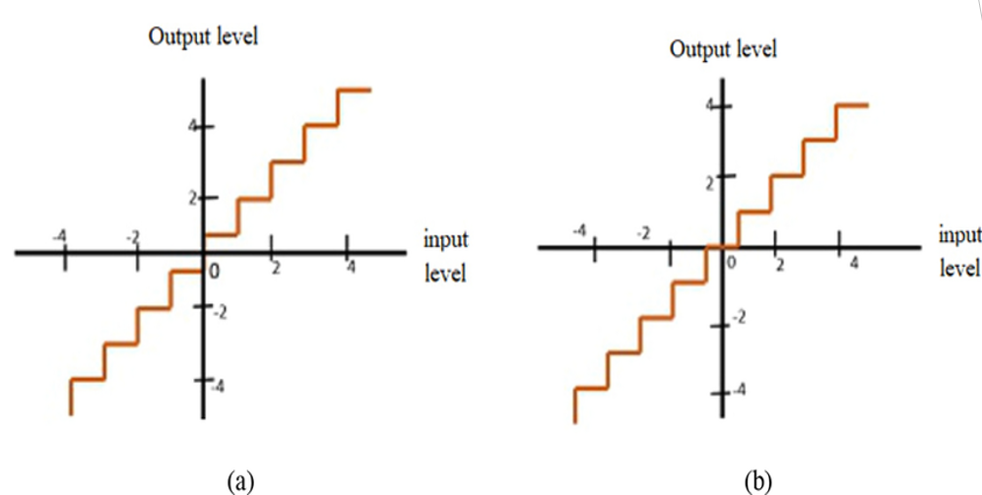
Quantizer Types: Mid-Rise and Mid-Tread

Slide 39
04
PART
Fixed-Point Representation

Slide 40
General format: Q1.m.n
sign bit
m = Range bits
n = fractional bits

Slide 41
Example: Q1.0.15 (16-bit signed fixed-point)
Q1.0.15 : Range –2⁰ to (2⁰ – 2⁻¹⁵) = - 1.0 to 1 - 2⁻¹⁵
Stored as (1+m+n)- bit signed integer

Slide 42
05
PART
Float-to-Fixed Conversion

Slide 43

Formula: Q1.m.n Fixedpt_value = round (Floatingpt_value × 2ⁿ)
01
Example 1Float = 0.4768, Q1.0.15 → round(0.4768 × 2¹⁵) = 15624
02
Example 2Float = –0.5792, Q1.0.15 → round(–0.5792 × 2¹⁵) = –18979

Slide 44
Formula: Q1.m.n Fixedpt_value = round (Floatingpt_value × 2ⁿ)
01
Example 1Float = 2.4897, Q1.2.13 → round(2.4897 × 2¹³) = 20396
02
Example 2Float = –5.5872, Q1.3.12 → round(–5.5872 × 2¹²) = -22885

Slide 45
Precision vs. Range Trade-off
More fractional bits → higher precision, smaller range
More integer bits → larger range, lower precision
Balance depends on algorithm

Slide 46
06
PART
Fixed-Point Arithmetic Examples

Slide 47
Addition/Subtraction
01
Straightforward, same Q format

Slide 48
How to add Q1.2.13 and Q1.3.12??
Will you convert Q1.2.13 to Q1.3.12?? Or Will you convert Q1.3.12 to Q1.2.13??

Slide 49
Multiplication
Q1.m.n × Q1.m.n = Q2.2m.2n → need to re- scale

Slide 50

Understanding Precision and Range in Fixed-Point Representation

Slide 51
Contents
1.
Fractional Bits and Precision
2.
Integer Bits and Range
3.
Balancing Precision and Range

Slide 52
PART.
01
Fractional Bits and Precision

Slide 53

Impact of More Fractional Bits
Higher Precision Explained
Increasing the number of fractional bits enhances the accuracy of numerical representation, allowing for more precise calculations, which is crucial in fields requiring detailed data.
Example: Q1.2.13 vs. Q1.2.29
The Q1.2.13 format provides limited precision compared to Q1.2.29, illustrating how the additional fractional bits in Q1.2.29 capture finer details in numerical values, affecting data integrity.

Slide 54
Trade-offs in Precision
01
02
Range Limitations
Real-world Applications
As more fractional bits are added, the range of representable values can decrease, leading to potential underflow or overflow issues that limit practical data use in various applications.
In engineering and computer graphics, the balance between precision and range is essential, influencing how data is processed and displayed in tools such as CAD software and gaming engines.

Slide 55
PART.
02
Integer Bits and Range

Slide 56
Importance of More Integer Bits
Larger Range Benefits
Examples in Data Representation
Increasing the number of integer bits allows for a greater range of values, enabling computers to accurately represent larger numbers without overflow, which is crucial for complex calculations.
In data representation, more integer bits can store larger integers, enhancing performance in applications like gaming and data analysis where numerical limits are often a concern.

Slide 57

Consequences of Increasing Integer Bits
Decreased Precision
While more bits increase the range, they can reduce precision in some contexts, affecting applications that rely on exact numeric representation, such as financial calculations.
.

Slide 58
PART.
03
Balancing Precision and Range

Slide 59
Understanding the Balance
Algorithmic Dependencies
01
Algorithmic dependencies refer to how various algorithms interact with data. Understanding these relationships helps in achieving optimal performance in precision and range while avoiding errors.
Practical Considerations
02
Practical considerations involve real- world factors such as computational resources, data variability, and context of use, influencing how to balance precision and range effectively in algorithm design.

Slide 60
07
PART
Practical Example

Slide 61
Design Steps
01
02
03
Specification
Select Parameters
Compute Coefficients
Define filter type (Low- pass, High- pass, Band- pass, Band- stop)
Pass band frequency Stop band frequency Pass band ripple Stop band attenuation
Using mathematical formulas (sinc + window) or tools (MATLAB/Python remez)
04
05
Implementation
Verification
Use convolution in C/Python (float or fixed- point)
Compare float vs fixed output (RMSE, PESQ for speech signals)

Slide 62

Total FIR Filter Coefficients is 13
01
02
03
Coefficients max: 2.786655772180386
Coefficients min: -2.9153372837924336
All Coefficients absolute sum: 23.597984136187275

Slide 63
How will you decide Q format for Coefficients??

Slide 64
1. Coeffs : 16-bit, Input: 16-bit, Output: 16-bit : RMSE = -50.549183 dB
2. Coeffs : 32-bit, Input: 16-bit, Output: 16-bit : RMSE = -52.707434 dB
3. Coeffs : 16-bit, Input: 32-bit, Output: 32-bit : RMSE = -54.919543 dB
4. Coeffs : 32-bit, Input: 32-bit, Output: 32-bit : RMSE = -126.177740 dB
5. Coeffs : 16-bit, Input: 16-bit, Output: 16-bit : Intermediate size 32-bit : RMSE = -50.549183 dB
6. Coeffs : 16-bit, Input: 16-bit, Output: 16-bit : Exploiting Guard Bits : RMSE = -52.676044 dB
7. Coeffs : 32-bit, Input: 16-bit, Output: 16-bit : Exploiting Guard Bits : RMSE = -52.707434 dB
8. Coeffs : 16-bit, Input: 32-bit, Output: 32-bit : Exploiting Guard Bits : RMSE = -76.243730 dB

Slide 65
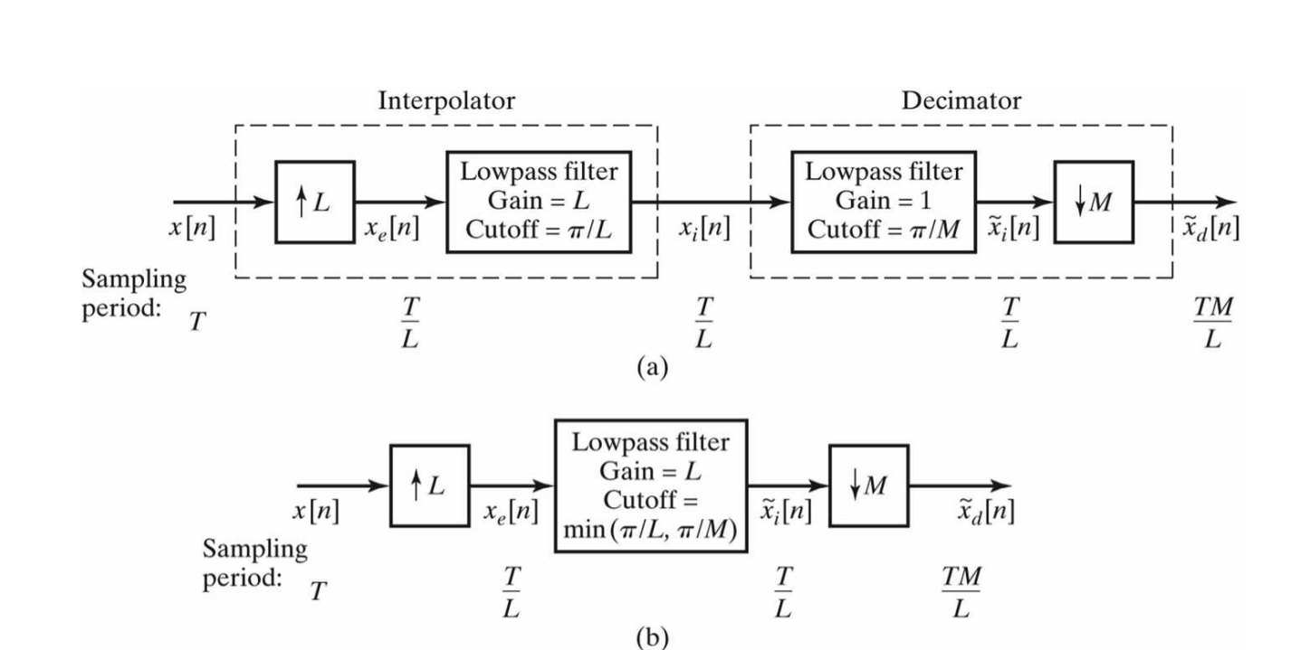

Slide 66
08
PART
Verification

Slide 67

Compare float vs fixed-point FIR outputs
Metrics RMSE, PESQ score for speech signals
PESQ score → indicates perceptual quality difference

Slide 68
09
PART
Summary

Slide 69
10
PART
Hands On

Slide 70
Thanks
PowerPoint Design

